Slide 1


HR ANALYTICS-EMPLOYEE RETENTION
BY
SUBODH RAM
RUKMINI POOJARI
SMITHA SOMESHWAR

Slide 2
OBJECTIVE
Firstly, we're identifying attrition patterns to predict and prevent turnover, ensuring our workforce remains stable and engaged. Secondly, we're refining our recruitment strategies to bring in top talent efficiently, saving time and resources. Thirdly, we're focusing on improving employee satisfaction and morale, creating a positive workplace culture that fosters productivity and loyalty. Additionally, we're optimizing training and development programs to help our employees grow and succeed in their roles. Lastly, we're analyzing diversity and inclusion metrics to build a workplace where everyone feels valued and respected.

Slide 3
Project Contents
KPI 1
KPI 2
KPI 3
KPI 4
KPI 5
KPI 6
Average Attrition rate for all Departments
Average Hourly Rate of Job Role
Attrition rate Vs Monthly income stats
Average working years for each Department
Job Role Vs Work life balance
Attrition rate Vs Year since last promotion relation

Slide 4
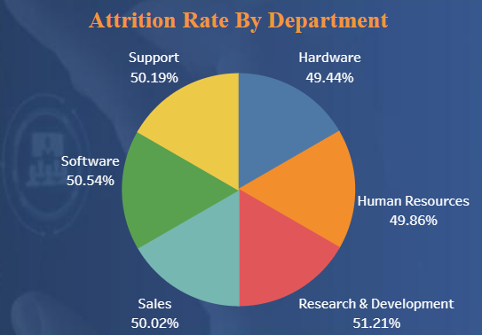
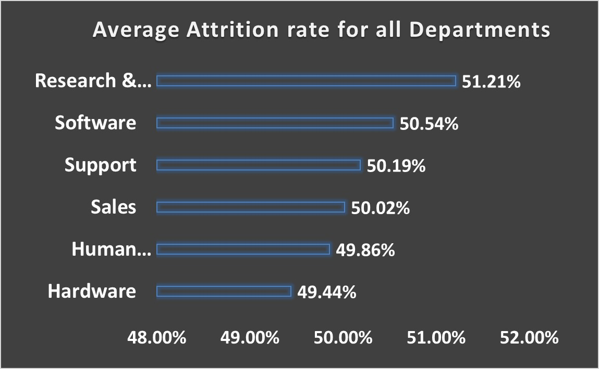
KPI 1
Average Attrition Rate for All Departments
Objective: Identify departments with higher attrition rates and understand potential underlying issues.
Approach:
Calculate attrition rates for each department.
Investigate reasons behind high attrition rates.
Insights:
High attrition rates may signal dissatisfaction, lack of growth opportunities, or poor management.
Addressing underlying issues crucial for retention and organizational health.

Slide 5
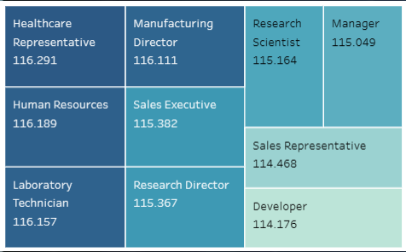
KPI 2
Average Hourly Rate By Job Role
Objective: Make sure everyone gets paid fairly and stays competitive in their pay
Approach:
Collect data on hourly rates for each job role.
Compare rates with industry benchmarks.
Analyze disparities among job roles.
Insights:
Identifying disparities aids in adjusting compensation packages to promote equity and retain talent.
Benchmarking ensures competitive compensation to attract and retain skilled employees.

Slide 6
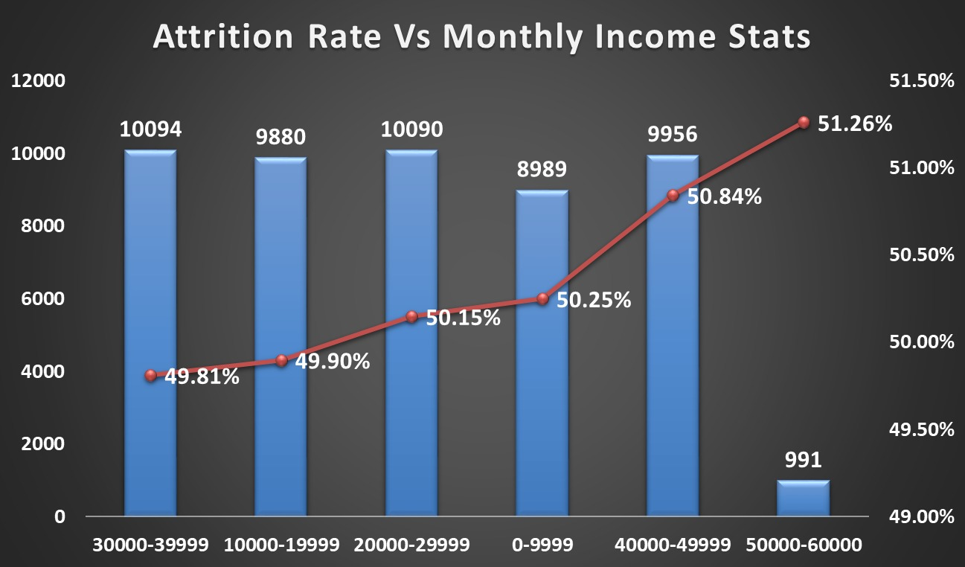
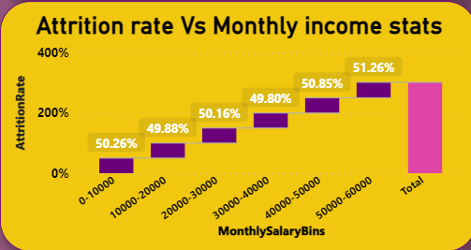
KPI 3
Attrition rate Vs Monthly income stats
Objective: Understand the relationship between attrition rates and monthly income levels.
Approach:
Analyze attrition rates across income brackets.
Investigate the underlying reasons for variations.
Insights:
Addressing discrepancies ensures targeted retention strategies, improving employee satisfaction and organizational stability.

Slide 7
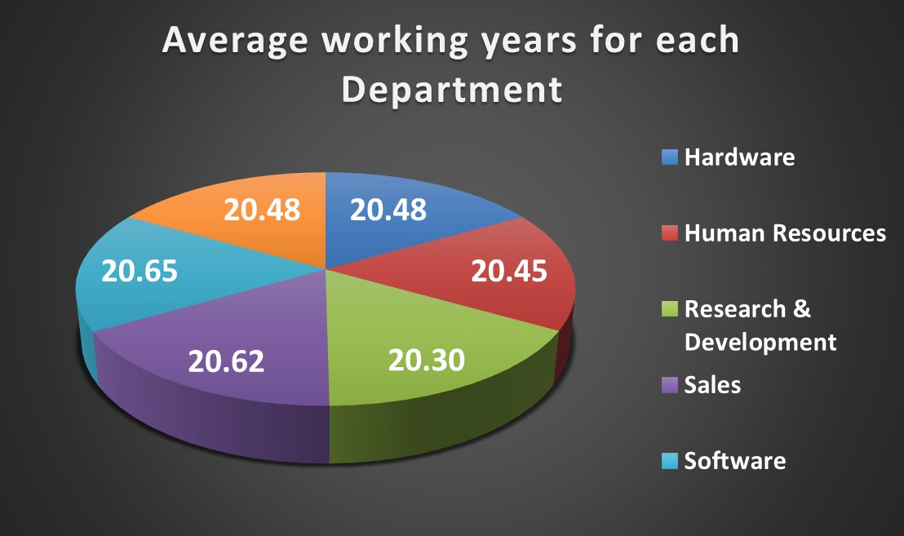
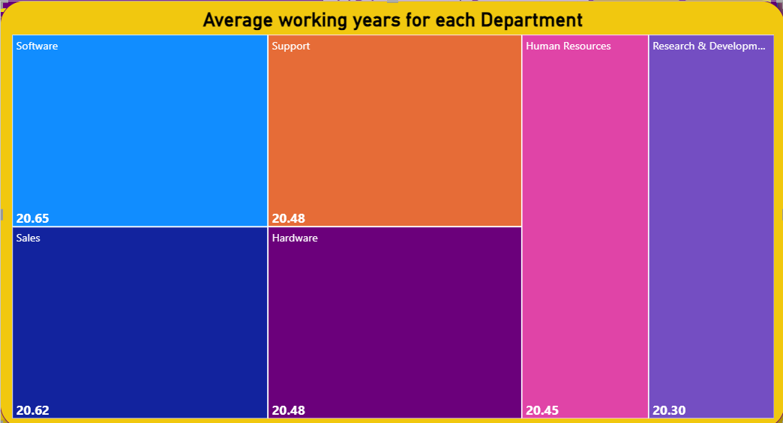
KPI 4
Average working years for each Department
Objective: Assess employee tenure and identify areas of stability or turnover within departments.
Approach:
Calculate average working years per department.
Analyze factors contributing to tenure differences.
Insights:
Longer tenure may indicate higher satisfaction, while shorter tenure may signal issues needing attention.

Slide 8
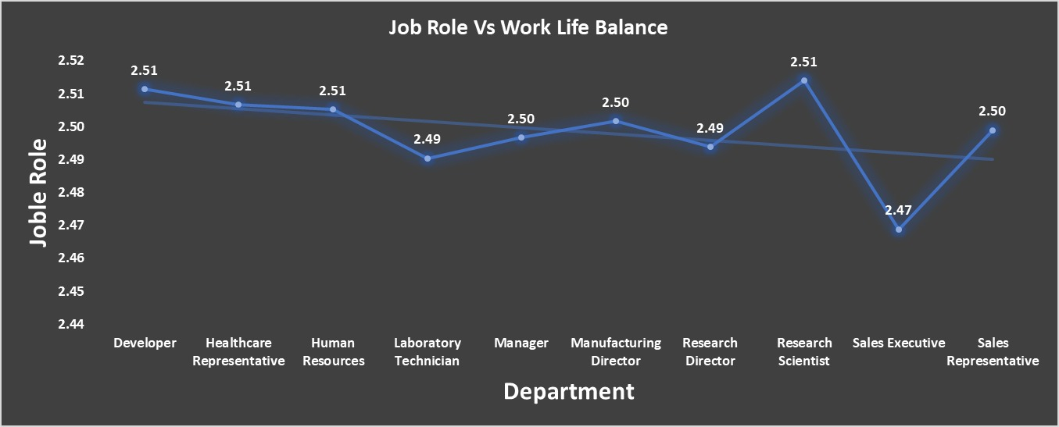
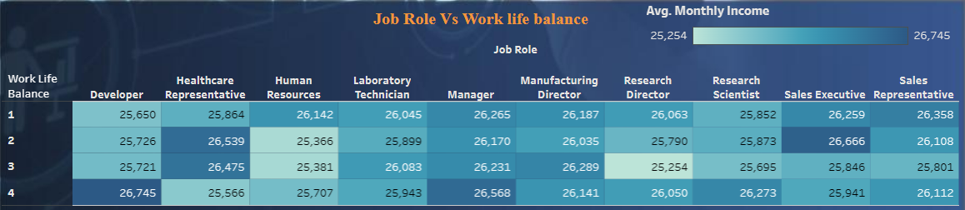
KPI 5
Job Role Vs Work life balance
Objective: Evaluate work-life balance perceptions across job roles.
Approach:
Gather feedback from employees.
Assess balance perceptions.
Insights:
Implementing initiatives improves satisfaction and retention by addressing balance concerns.

Slide 9
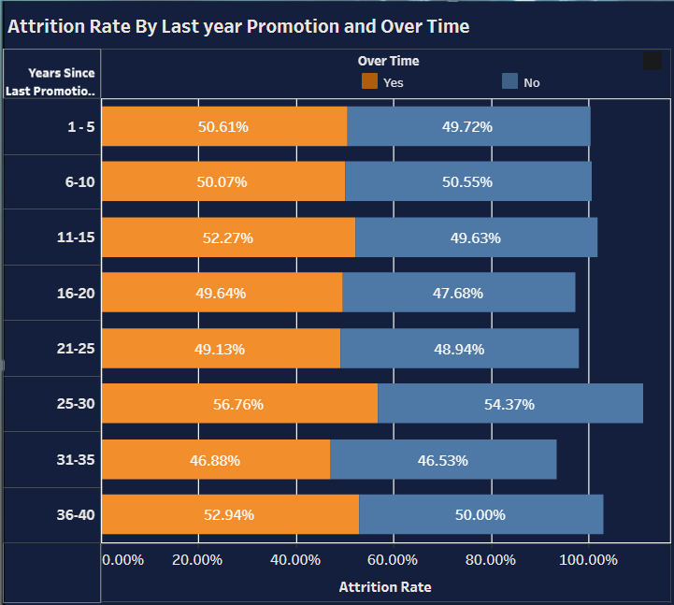
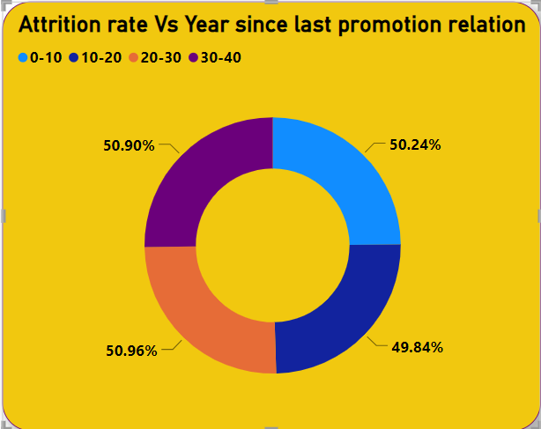
KPI 6
Attrition rate Vs Year since last promotion relation
Objective: Understand the relationship between attrition rates and time since last promotion.
Approach:
Analyze attrition rates based on promotion timeline.
Insights:
Longer time since promotion may indicate limited advancement opportunities, highlighting the need for clear career paths.

Slide 10
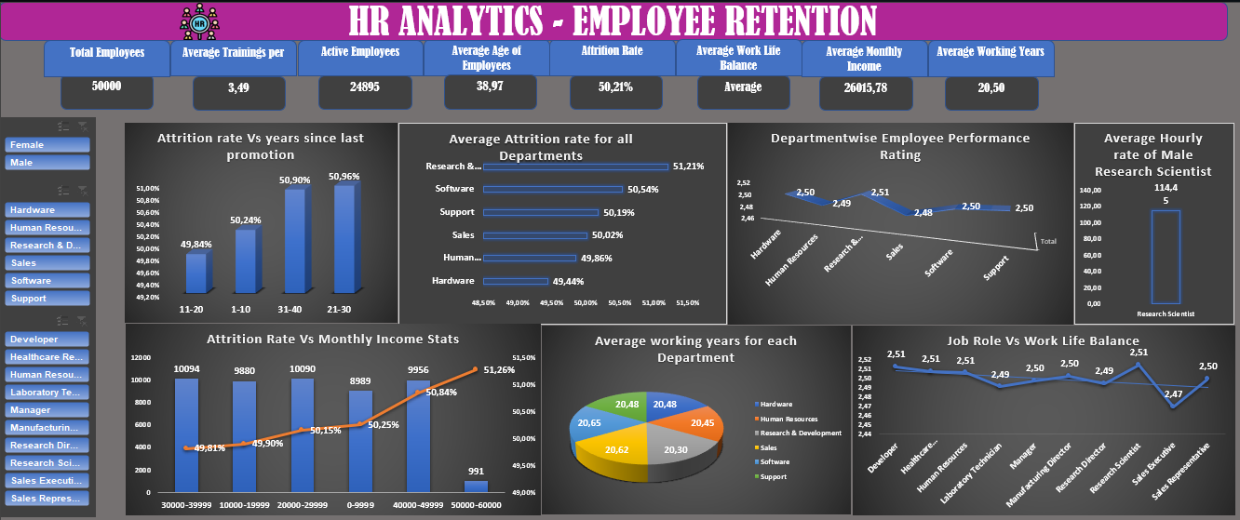
HR ANALYTICS Dashboard in Excel Platform

Slide 11

HR ANALYTICS Dashboard in PowerBI Platform
LIVE

Slide 12
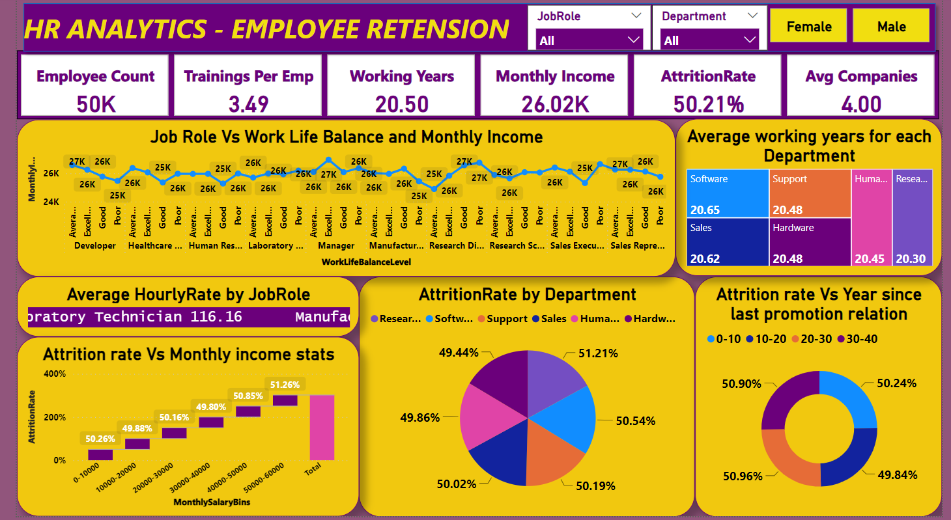
HR ANALYTICS Dashboard in PowerBI Platform

Slide 13
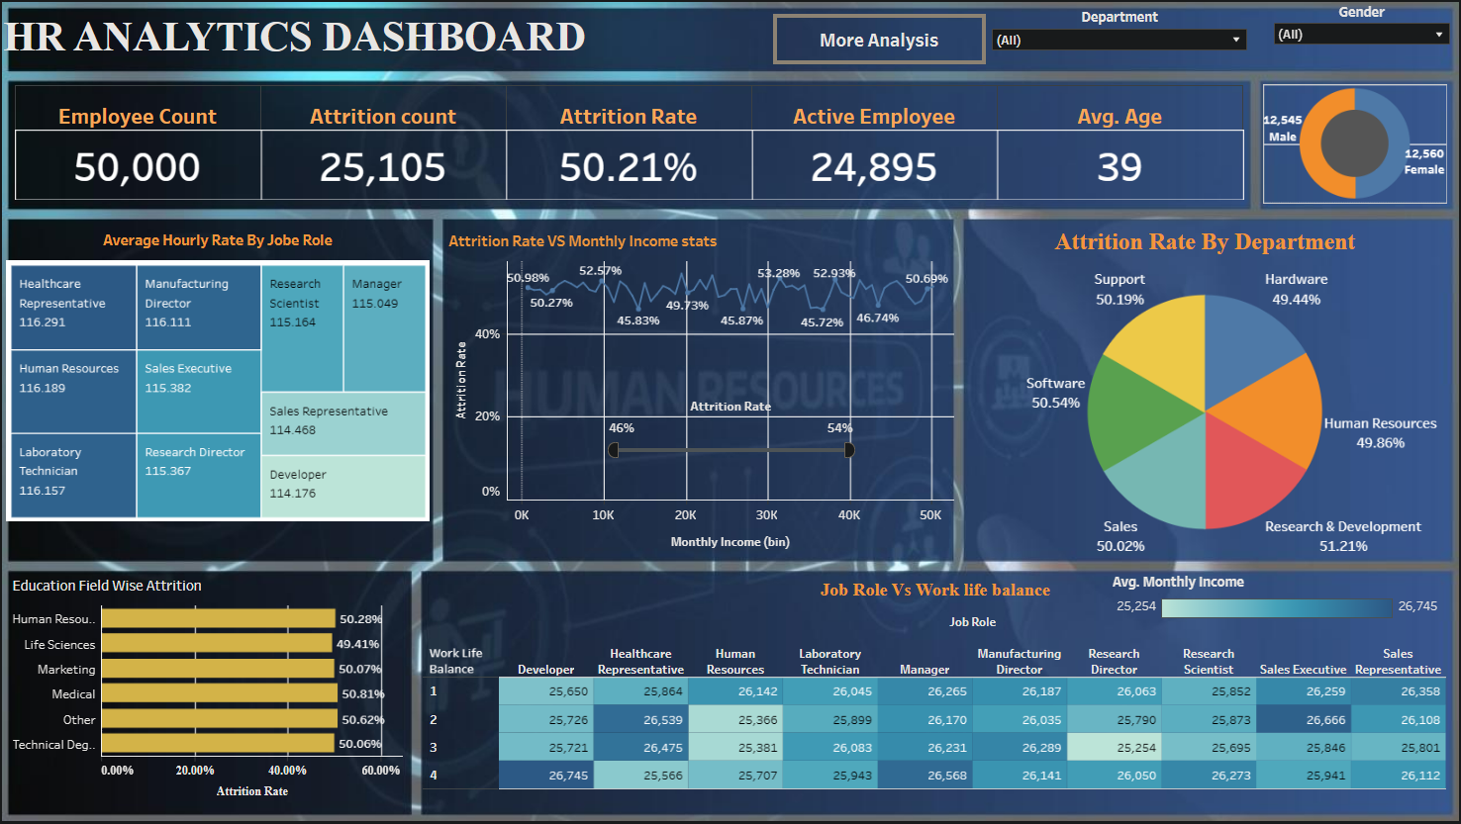
HR ANALYTICS Dashboard in Tableau Platform
1

Slide 14
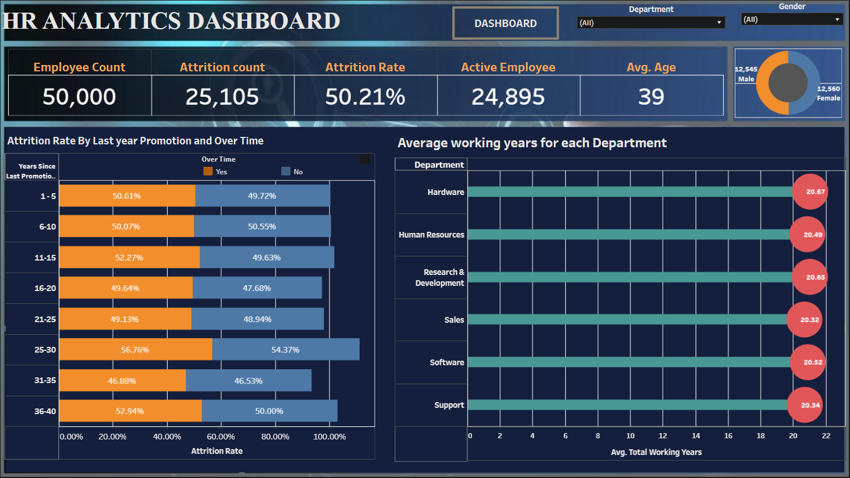
HR ANALYTICS Dashboard in Tableau Platform
2

Slide 15
EMPLOYEE DATABASE Analysis (SQL - Structured Query Language )
Introduction:
Welcome, everyone! Today, we're embarking on an exciting journey into our employee database using a powerful tool called SQL. But first, let's set the stage.
Employee Database Analysis:
Imagine our employee database as a treasure trove of information about our team. By exploring this data, we can learn valuable insights about our employees – who they are, how they're performing, and what makes them thrive at work. This exploration will help us make smarter decisions about hiring, training, and creating an even better workplace.
Introduction to SQL:
Now, you might be wondering, how do we unlock all this valuable information? That's where SQL comes in! SQL, or Structured Query Language, is like the magic key that lets us talk to our database. With SQL, we can ask questions, retrieve specific data, and analyze trends – all in a simple and powerful way.
So, get ready to join us as we dive into our employee database using SQL. It's time to uncover insights that will help us make our company an even better place to work!

Slide 16
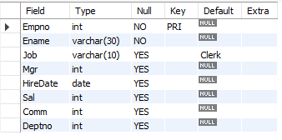
Create the Employee Table as per the below data in the table
Note : Ensure the Salary is not less than zero
Empno cannot be null or Duplicate.
Default Job should be Clerk
CREATE TABLE Employee (
Empno INT PRIMARY KEY,
Ename VARCHAR(30) NOT NULL,
Job VARCHAR(10) DEFAULT 'Clerk',
Mgr INT,
HireDate DATE,
Sal INT CHECK (Sal >= 0),
Comm INT,
Deptno INT
);

Slide 17
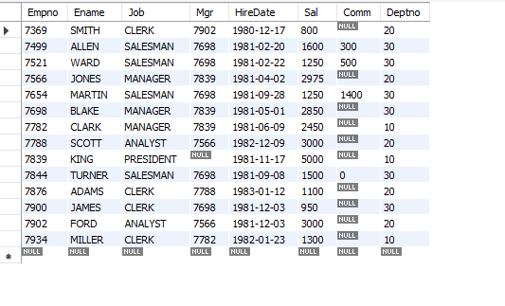
Select * from employee; Below is the output:
INSERT INTO Employee (Empno, Ename, Job, Mgr, HireDate, Sal, Comm, Deptno)
VALUES (7839, 'KING', 'PRESIDENT', NULL, '1981-11-17', 5000, NULL, 10);
INSERT INTO Employee (Empno, Ename, Job, Mgr, HireDate, Sal, Comm, Deptno)
VALUES (7698, 'BLAKE', 'MANAGER', 7839, '1981-05-01', 2850, NULL, 30);
INSERT INTO Employee (Empno, Ename, Job, Mgr, HireDate, Sal, Comm, Deptno)
VALUES (7782, 'CLARK', 'MANAGER', 7839, '1981-06-09', 2450, NULL, 10);
INSERT INTO Employee (Empno, Ename, Job, Mgr, HireDate, Sal, Comm, Deptno)
VALUES (7566, 'JONES', 'MANAGER', 7839, '1981-04-02', 2975, NULL, 20);
INSERT INTO Employee (Empno, Ename, Job, Mgr, HireDate, Sal, Comm, Deptno)
VALUES (7654, 'MARTIN', 'SALESMAN', 7698, '1981-09-28', 1250, 1400, 30);
INSERT INTO Employee (Empno, Ename, Job, Mgr, HireDate, Sal, Comm, Deptno)
VALUES (7499, 'ALLEN', 'SALESMAN', 7698, '1981-02-20', 1600, 300, 30);
INSERT INTO Employee (Empno, Ename, Job, Mgr, HireDate, Sal, Comm, Deptno)
VALUES (7844, 'TURNER', 'SALESMAN', 7698, '1981-09-08', 1500, 0, 30);
INSERT INTO Employee (Empno, Ename, Job, Mgr, HireDate, Sal, Comm, Deptno)
VALUES (7900, 'JAMES', 'CLERK', 7698, '1981-12-03', 950, NULL, 30);
INSERT INTO Employee (Empno, Ename, Job, Mgr, HireDate, Sal, Comm, Deptno)
VALUES (7521, 'WARD', 'SALESMAN', 7698, '1981-02-22', 1250, 500, 30);
INSERT INTO Employee (Empno, Ename, Job, Mgr, HireDate, Sal, Comm, Deptno)
VALUES (7902, 'FORD', 'ANALYST', 7566, '1981-12-03', 3000, NULL, 20);
INSERT INTO Employee (Empno, Ename, Job, Mgr, HireDate, Sal, Comm, Deptno)
VALUES (7369, 'SMITH', 'CLERK', 7902, '1980-12-17', 800, NULL, 20);
INSERT INTO Employee (Empno, Ename, Job, Mgr, HireDate, Sal, Comm, Deptno)
VALUES (7788, 'SCOTT', 'ANALYST', 7566, '1982-12-09', 3000, NULL, 20);
INSERT INTO Employee (Empno, Ename, Job, Mgr, HireDate, Sal, Comm, Deptno)
VALUES (7876, 'ADAMS', 'CLERK', 7788, '1983-01-12', 1100, NULL, 20);
INSERT INTO Employee (Empno, Ename, Job, Mgr, HireDate, Sal, Comm, Deptno)
VALUES (7934, 'MILLER', 'CLERK', 7782, '1982-01-23', 1300, NULL, 10);

Slide 18
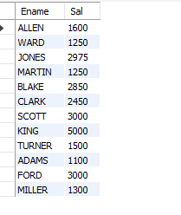
SELECT Ename, Sal FROM Employee WHERE Sal > 1000;
2. List the Names and salary of the employees whose salary is greater than 1000

Slide 19
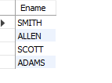
SELECT Ename FROM Employee WHERE Ename LIKE 'A%' OR Ename LIKE 'S%';
3. List Employee Names whose names start with either A or S.

Slide 20
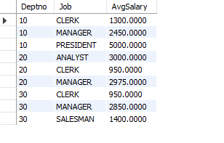
select Deptno , job ,avg(sal)as AvgSalary from employeegroup by Deptno,joborder by Deptno;
4. List average monthly salary for each job within each department

Slide 21
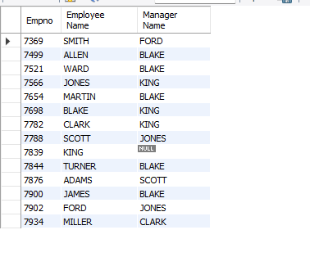
5. Display the empno, Emp name and the Manager name under whom the Employee works
SELECT
e.Empno,
e.Ename AS "Employee Name",
m.Ename AS "Manager Name"
FROM
Employee e
LEFT JOIN
Employee m ON e.Mgr = m.Empno;

Slide 22
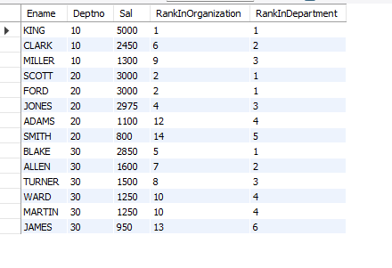
SELECT Ename, Deptno, Sal, RANK() OVER (ORDER BY Sal DESC) AS RankInOrganization, RANK() OVER (PARTITION BY Deptno ORDER BY Sal DESC) AS RankInDepartment FROM employee;
6. Display Empname, department no, salary , Rank of salary in Organisation , Rank of Salary in their respective department

Slide 23
Conclusion:
Through the analysis of key HR KPIs, we've gained valuable insights into our organization's dynamics. By identifying departments with high attrition rates, addressing underlying issues, ensuring fairness in compensation, and promoting work-life balance, we're poised to enhance retention and organizational health. Leveraging these insights, we can create a positive work environment, foster employee engagement, and drive organizational success.

Slide 24
Thank you

